Slide 1
离散数据及其应用 Discrete Mathematics and Its Applications （Eighth Edition/Kenneth H.Rosen） 郭少勇 (syguo@bupt.edu.cn) 北京邮电大学 2023.12

Slide 2
期中考试内容

Slide 3
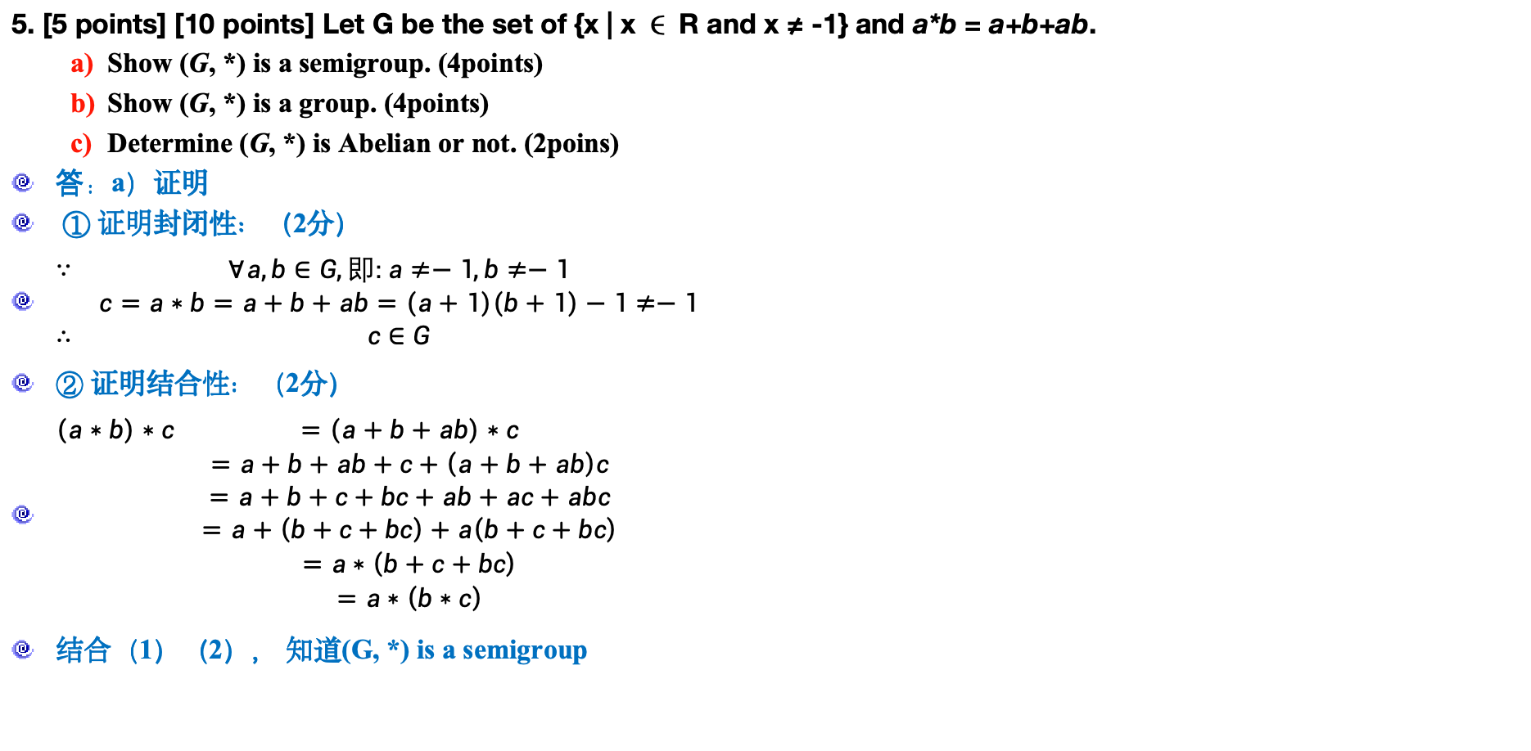
期中考试内容-5
5. [5 points] [10 points] Let G be the set of {x | x ∈ R and x ≠ -1} and a*b = a+b+ab.
Show (G, *) is a semigroup. (4points)
Show (G, *) is a group. (4points)
Determine (G, *) is Abelian or not. (2poins)
答：a）证明
① 证明封闭性：（2分）
$\begin{matrix}∵ & ∀a,b∈G,即:a≠−1,b≠−1 \\ & c=a∗b=a+b+ab=\left(a+1\right)\left(b+1\right)−1≠−1 \\ ∴ & c∈G\end{matrix}$
② 证明结合性：（2分）
$\begin{matrix}\left(a∗b\right)∗c & =\left(a+b+ab\right)∗c \\ & =a+b+ab+c+\left(a+b+ab\right)c \\ & =a+b+c+bc+ab+ac+abc \\ & =a+\left(b+c+bc\right)+a\left(b+c+bc\right) \\ & =a∗\left(b+c+bc\right) \\ & =a∗\left(b∗c\right)\end{matrix}$
结合（1）（2）， 知道(G, *) is a semigroup

Slide 4
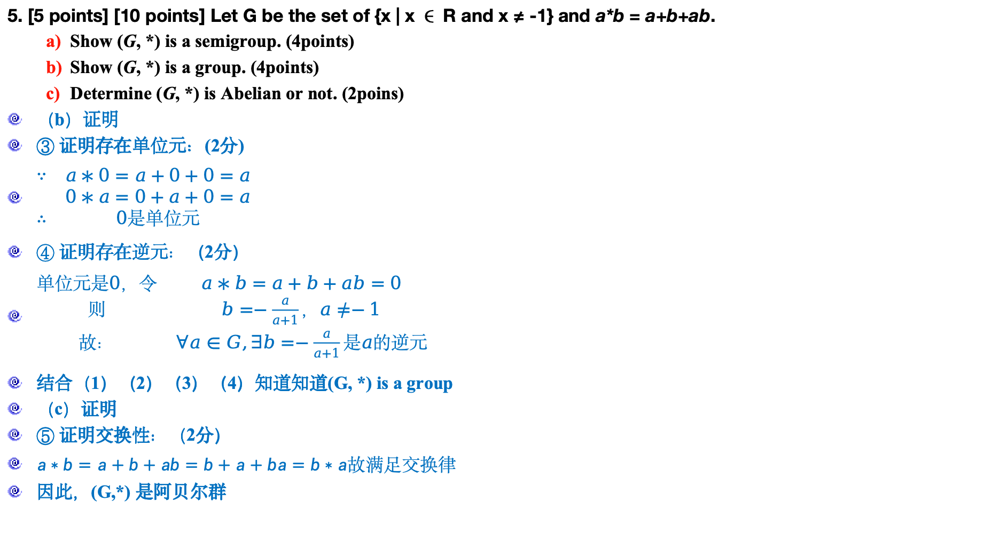
期中考试内容-5
5. [5 points] [10 points] Let G be the set of {x | x ∈ R and x ≠ -1} and a*b = a+b+ab.
Show (G, *) is a semigroup. (4points)
Show (G, *) is a group. (4points)
Determine (G, *) is Abelian or not. (2poins)
（b）证明
③ 证明存在单位元：(2分)
$\begin{matrix}∵ & a∗0=a+0+0=a \\ & 0∗a=0+a+0=a \\ ∴ & 0是单位元\end{matrix}$
④ 证明存在逆元：（2分）
$\begin{matrix}单位元是0，令 & a∗b=a+b+ab=0 \\ 则 & b=−\frac{a}{a+1}，a≠−1 \\ 故： & ∀a∈G,∃b=−\frac{a}{a+1}是a的逆元\end{matrix}$
结合（1）（2）（3）（4）知道知道(G, *) is a group
（c）证明
⑤ 证明交换性：（2分）
$\begin{matrix}a∗b=a+b+ab=b+a+ba=b∗a故满足交换律\end{matrix}$
因此，(G,*) 是阿贝尔群

Slide 5
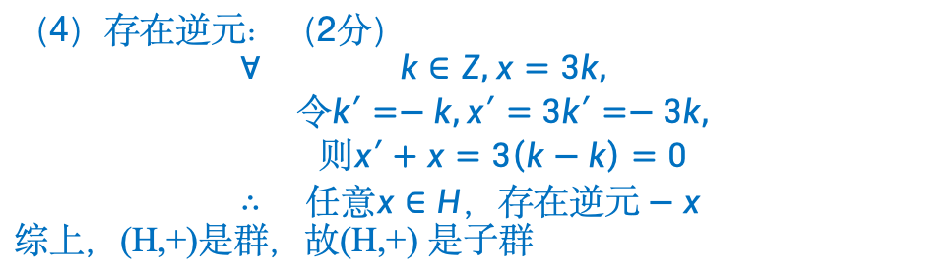
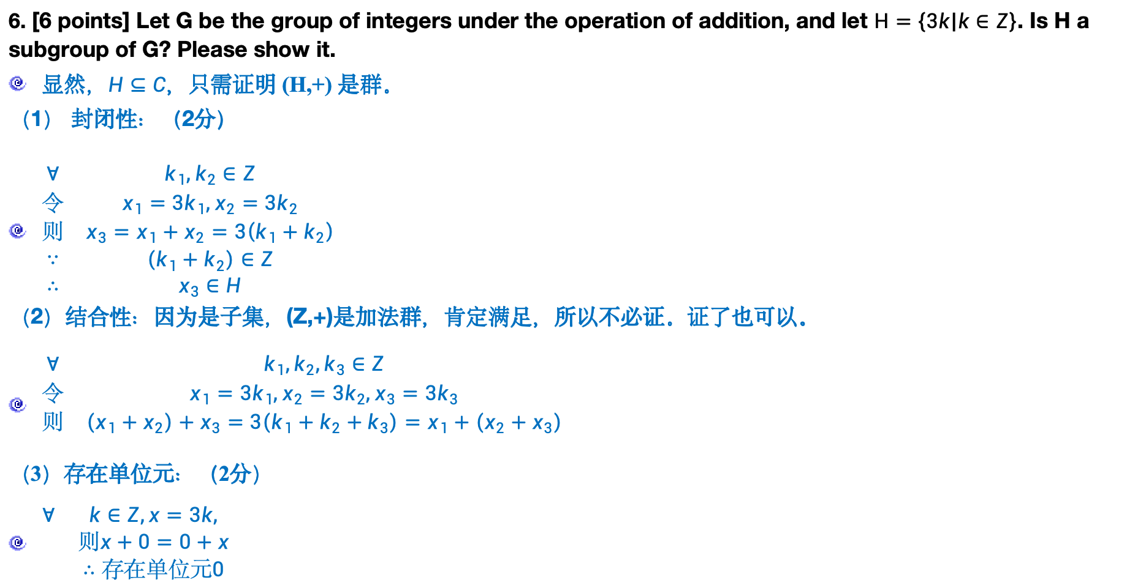
期中考试内容-6
6. [6 points] Let G be the group of integers under the operation of addition, and let $H=\left\{3k | k∈Z\right\}$. Is H a subgroup of G? Please show it.
显然，$H⊆C$，只需证明 (H,+) 是群。
（1） 封闭性：（2分）
$\begin{matrix}∀ & k_{1},k_{2}∈Z \\ 令 & x_{1}=3k_{1},x_{2}=3k_{2} \\ 则 & x_{3}=x_{1}+x_{2}=3\left(k_{1}+k_{2}\right) \\ ∵ & \left(k_{1}+k_{2}\right)∈Z \\ ∴ & x_{3}∈H\end{matrix}$
（2）结合性：因为是子集，(Z,+)是加法群，肯定满足，所以不必证。证了也可以。
$\begin{matrix}∀ & k_{1},k_{2},k_{3}∈Z \\ 令 & x_{1}=3k_{1},x_{2}=3k_{2},x_{3}=3k_{3} \\ 则 & \left(x_{1}+x_{2}\right)+x_{3}=3\left(k_{1}+k_{2}+k_{3}\right)=x_{1}+\left(x_{2}+x_{3}\right) \\ & \end{matrix}$
（3）存在单位元：（2分）
$\begin{matrix}∀ & k∈Z,x=3k, \\ & 则x+0=0+x \\ & ∴存在单位元0\end{matrix}$
（4）存在逆元：（2分）
$$\begin{matrix}∀ & k∈Z,x=3k, \\ & 令k′=−k,x′=3k′=−3k, \\ & 则x′+x=3\left(k−k\right)=0 \\ ∴ & 任意x∈H，存在逆元−x\end{matrix}$$
综上，(H,+)是群，故(H,+) 是子群

Slide 6
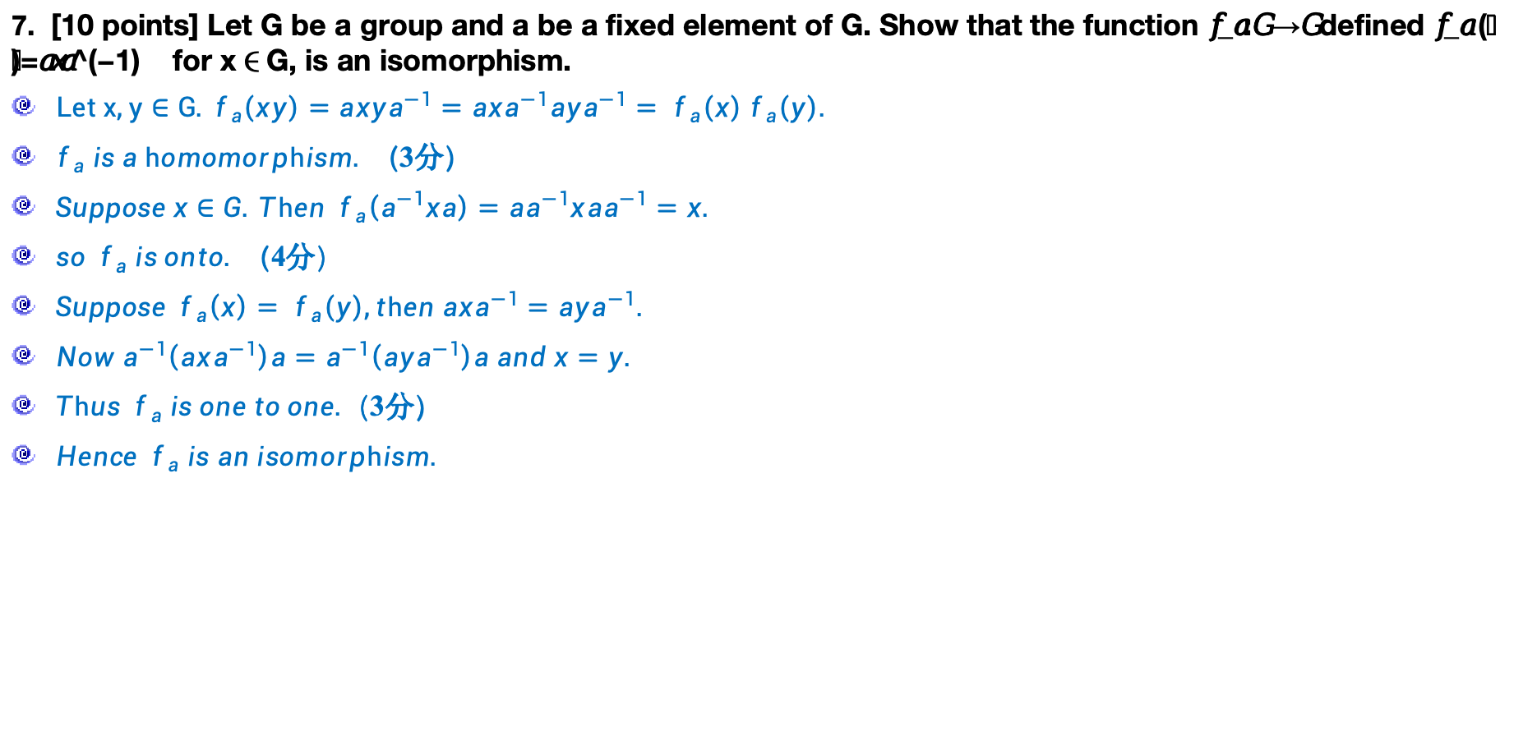
期中考试内容-7
7. [10 points] Let G be a group and a be a fixed element of G. Show that the function 𝑓_𝑎:𝐺 →𝐺 defined 𝑓_𝑎 (𝑥)=𝑎𝑥𝑎^(−1) for x∈G, is an isomorphism.
$Let x,y∈G.{ f}_{a}\left(xy\right)=ax{ya}^{−1}=axa^{−1}aya^{−1}={ f}_{a}\left(x\right){ f}_{a}\left(y\right).$
$f_{a} is a homomorphism.$（3分）
$Suppose x∈G. Then { f}_{a}\left(a^{−1}xa\right)=aa^{−1}xaa^{−1}=x.$
$so { f}_{a} is onto.$（4分）
$Suppose { f}_{a}\left(x\right)={ f}_{a}\left(y\right),then axa^{−1}=aya^{−1}.$
$Now a^{−1}\left(axa^{−1}\right)a=a^{−1}\left(aya^{−1}\right)a and x=y.$
$Thus { f}_{a} is one to one.$（3分）
$Hence { f}_{a} is an isomorphism.$

Slide 7
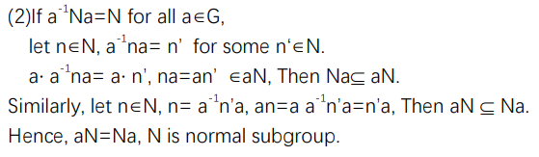
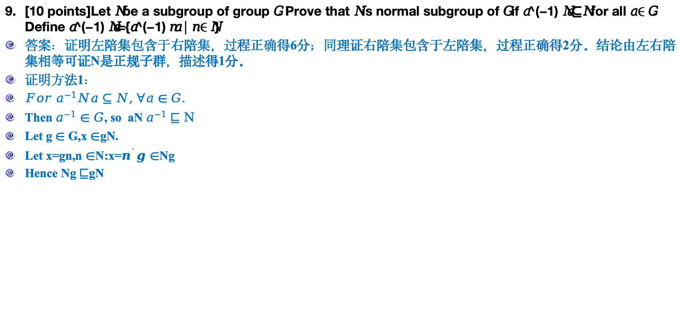
期中考试内容-9
[10 points]Let 𝑁 be a subgroup of group 𝐺. Prove that 𝑁 is normal subgroup of 𝐺 if 𝑎^(−1) 𝑁𝑎⊆𝑁 for all 𝑎∈𝐺. Define 𝑎^(−1) 𝑁𝑎={𝑎^(−1) 𝑛𝑎│𝑛∈𝑁}
答案：证明左陪集包含于右陪集，过程正确得6分；同理证右陪集包含于左陪集，过程正确得2分。结论由左右陪集相等可证N是正规子群，描述得1分。
证明方法1：
$For a^{−1}Na⊆N,$ $∀a∈G.$
Then $a^{−1}∈G$, so aN $a^{−1}⊑N$
Let g $∈$ G,x $∈$gN.
Let x=gn,n $∈$N:x=$n^{`}g∈$Ng
Hence Ng $⊑$gN

Slide 8
课程复习内容

Slide 9
9 Relation
9.1 Relations and Their Properties 关系及关系性质
9.2 n-ary Relations and Their Applications n元关系及应用
9.3 Representing Relations 关系的表示
9.4 Closures of Relations 关系闭包
9.5 Equivalence Relations 等价关系
9.6 Partial Orderings 偏序关系

Slide 10
9.1 Relations and Their Properties
Ordered pair（有序对）
Cartesian product（笛卡尔积）
Partitions（划分）
Definition
Let A and B be nonempty sets. A relation R from A to B is a subset of A × B.
Sets Arising from Relations
Special Properties of Binary Relations
Reflexive and Irreflexive（自反、反自反）
Symmetric, Asymmetric, and Antisymmetric（对称、非对称、反对称）
Transitive（传递）

Slide 11
9.2 n-ary Relations and Their Applications
Combing relations
R₂ ∪ R₁
R₂ ∩ R₁
R₂ − R₁
R₂ ⊕ R₁
R₁
Composition
Suppose A, B, and C are sets, R is a relation from A to B, and S is a relation from B to C.
The composition of R and S, written as S□R, is a relation from A to C and defined as:
if a is in A and c is in C, then a S□R c if and only if for some b in B, a R b and b S c.

Slide 12

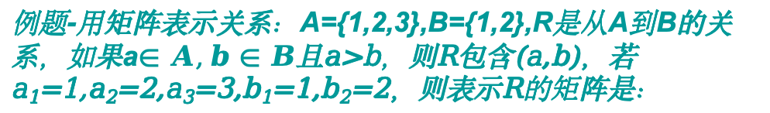
9.3 Representing Relations
With a zero-one matrix.
With a directed graph.
Reflexive,irreflexive（自反、反自反）,
symmetric, asymmetric, and antisymmetric （对称、非对称、反对称）
transitive（传递）
The complement?
The relative complement?
The symmetric difference?
Combining Connection Matrices
Join
meet
Composite of relations
例题-用矩阵表示关系：A={1,2,3},B={1,2},R是从A到B的关系，如果a$∈A,b∈B$且a>b，则R包含(a,b)，若a₁=1,a₂=2,a₃=3,b₁=1,b₂=2，则表示R的矩阵是：

Slide 13
9.4 Closures of Relations
reflexive closure r(R)（自反闭包）
R∪Δ
Add loops to all vertices on the digraph representation of R.
Put 1’s on the diagonal of the connection matrix of R.
symmetric closure s(R)（对称闭包）
R∪R⁻¹
add arcs in the opposite direction.
transitive closure（传递闭包）
if there is a path from a to b, add an arc from a to b.
R^{n} : x R^{n} y means that there is a path of length n from x to y in R.
The connectivity relation R∗ consists of the pairs (a, b) such that there is a path of length at least one from a to b in R.

Slide 14
9.4 Closures of Relations
Warshall’s Algorithm
W_{k}: a Boolean matrix, for 1≤k≤n
W_{k} has a 1 in position i, j
If and only if
there is a path from a_{i} to a_{j} in R whose interior vertices, if any, come from the set {a₁, a₂,…, a_{k}}
W₀ = M_{R}
W_{n} =
W₀, W₁ , W₂ , … , W_{n}
Step1:
First transfer to W_{k} all 1’s in W_{k-1}.
Step2:
List the locations p₁, p₂, …, in column k of W_{k-1}, where the entry is 1
List the locations q₁, q₂, …, in row k of W_{k-1}, where the entry is 1
Step3:
Put 1’s in all the positions p_{i}, q_{j} of W_{k} (if they are not already there)

Slide 15
9.5 Equivalence Relations
A relation R on a set A is an equivalence relation (等价关系) iff R is
Reflexive（自反）
Symmetric（对称）
Transitive（传递）
equivalence class（等价类）
Let P be a partition of a set A. Define the relation R on A as follows:
a R b If and only if a and b are members of the same block.
Then R is an equivalence relation on A
Let R be an equivalence relation on A, and let P be the collection of all distinct relative sets R(a) for a in A.
Then P is a partition of A, and R is the equivalence relation determined by P

Slide 16
9.5 Equivalence Relations
例题-设R是定义在实数集上的关系，满足aRb当且仅当a-b是整数。R是等价关系吗?
解：
因为对所有的实数a,a—a=0是整数，即对所有的实数a,有aRa,因此R是自反的。
假设aRb,那么a-b是整数，所以b-a也是整数。因此有bRa。由此，R是对称的。
如果aRb且bRc,那么a-b和b-c是整数，所以a-c=(a-b)+(b-c)也是整数。因此aRc。所以，R是传递的。
综上所述，R是等价关系

Slide 17
9.6 Partial Orderings
A relation R on a set A is called a partial order（偏序） if R is reflexive（自反）, antisymmetric（反对称）, and transitive（传递）
If every pair of elements in a poset A is comparable, we say that A is a linearly ordered set（or totally ordered)（线序/全序）, and the partial order is called a linear order. We also say that A is a chain.
A relation R on a set A is called quasiorder（先序） if it is transitive and irreflexive.
If (A,≤) and (B,≤) are posets,then (A×B,≤) is a poset,with partial order ≤ define by
This ordering is called product partial order（积偏序）
If (A,≤) and (B,≤) are posets,then (A×B, ) is a poset,with partial order define by
This ordering is called lexicographic（字典式的）, or “dictionary” order（字典顺序）.

Slide 18
9.6 Partial Orderings
Hasse Diagram（哈赛图） is the digraph of a partial order on a finite set A that
deletes all self-cycles
eliminates all edges that are implied by the transitive property
draws the digraph with all edges pointing upward
Topological Sorting（拓扑排序）
Isomorphism（同构）
Principle of Correspondence（对应原理）

Slide 19
9.6 Partial Orderings
maximal element（极大元）
minimal element（极小元）
greatest element（最大元）
denoted by I and often called the unit element（单位元）
least element（最小元）
denoted by 0 and often called the zero element（零元）

Slide 20
9.6 Partial Orderings
An element a ∈ A is called a upper bound（上界） of B if b≤a for all b ∈ B.
An element a ∈ A is called a lower bound（下界）of B if a≤b for all b ∈ B.
An element a ∈ A is called a least upper bound (LUB) of B if a is an upper bound of B and a≤a’, whenever a’ is an upper bound of B.
An element a ∈ A is called a greatest lower bound (GLB) of B if a is an lower bound of B and a’≤a, whenever a’ is an lower bound of B.
Lattice（格）
Sublattice（子格）
Isomorphic Lattices（同构格）

Slide 21
Mathematical structure
A collection of objects with operations defined on them and the accompanying properties form a mathematical structure or system.
A structure is closed with respect to an operation if that operation always produces another member of the collection of objects.
If x y = y x, where is some binary operation, is commutative（交换的）
If is a binary operation, then is associative or has the associative（可结合） property if (x y) z =x (y z).
If a mathematical structure has two binary operations, say and ∇, a distributive property has the following pattern: x (y ∇ z)= (x y) ∇(x z).

Slide 22
Mathematical structure
If the unary operation is * and the binary operations are and ∇. then De Morgan‘s laws（德摩根律） are
(x y)* =x* ∇ y* and (x ∇ y)* =x* y*.
A structure with a binary operation may contain a distinguished object e, with the property x e = e x = x for all x in the collection. We call e an identity for .
If a binary operation has an identity e, we say y is a -inverse of x if x y=y x=e.
A binary operation on a set A is an everywhere defined function f:A×A →A.

Slide 23
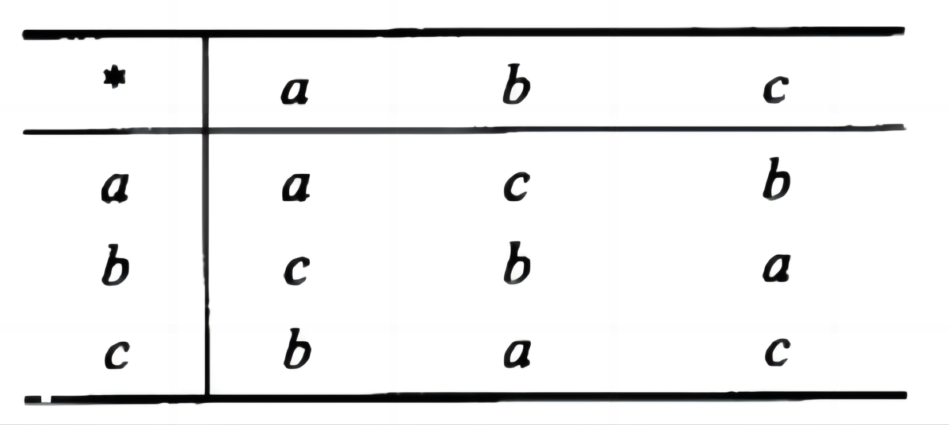
Semigroup（半群）
A semigroup is a nonempty （非空）set S together with an associative binary operation * defined on S.
The semigroup (A*, ⋅ ) is called the free semigroup(自由半群) generated by A.
An element e in a semigroup (S, *) is called an
identity element（单位元） if e*a = a*e = a for all a ∈S.
A monoid（独异点） is a semigroup (S, *)
that has an identity.
Subsemigroup
Submonoid
Let (S, *) and (T, *‘) be two semigroups. A function f : S→T is called an isomorphism（同构） from (S, *) to (T, *') if
it is a one-to-one correspondence from S to T
and f(a*b) = f(a)*'f(b) for all a and b in S.
Let (S, *) and (T, *‘) be two semigroups. An everywhere-defined function f :S→ T is called a homomorphism（同态） from (S, *) to (T, *')
If f(a*b) = f(a) *' f(b) for all a and b in S.
If f is also onto, we say that T is a homomorphic image(同态像) of S.
例题-用下表定义了一个半群或幺半群吗？

Slide 24
Products and Quotients of Semigroups
If (S, *) and (T, *') are semigroups, then (S×T, *") is a semigroup, where *" is defined by (s₁, t_{l})*"(s₂, t₂) = (s_{l}*s₂, t_{l}*'t₂)
if S and T are monoids with identities e_{S} and e_{T}, respectively then S×T is a monoid with identity (e_{S}, e_{T}).
An equivalence relation R on the semigroup (S, *) is called a congruence relation（同余关系） if a R a' and b R b' Imply (a*b) R (a'*b')
Let R be a congruence relation on the semigroup (S, *). Consider the relation  from S/R × S/R to S/R in which the ordered pair ([a], [b]) is, for a and b in S, related to [a*b].
([a], [b]) = [a][b] = [a*b], is a function from S/R×S/R to S/R
(S/R, ) is a semigroup. S/R is called the quotient semigroup(商半群) or factor semigroup（因子半群）

Slide 25
Products and Quotients of Semigroups
Let R be a congruence relation on the monoid (S, *). If we define the operation  in S/R by [a][b] = [a*b], then (S/R, ) is a monoid.
Let R be a congruence relation on a semigroup (S, *), and (S/R, ) be the corresponding quotient semigroup. Then the function f_{R}: S→S/R defined by f_{R}(a) = [a] is an onto homomorphism, called the natural homomorphism(自然同态).
Let
f: S→T be a homomorphism of the semigroup (S, *) onto（满射） the semigroup (T, *').
R be the relation on S defined by a R b if and only if f(a) = f(b), for a and b in S.
Then
R is a congruence relation.
(T, *‘) and the quotient semigroup (S/R, ) are isomorphic（同构）.
f
S
T
f_{R}
f
S/R

Slide 26
Groups
A group (G, *) is a set together with a binary operation * on G such that, for any elements a, b, and c in G
(a*b)*c = a*(b*c).
a unique element e in G such that a*e = e*a
an element a' ∈ G, called an inverse of a and written as a⁻¹, such that
a*a' = a'*a = e or aa' = a'a = e or aa⁻¹ = a⁻¹a = e
A group G is said to be Abelian if ab = ba for all elements a and b in G.
Let G be a group and a, b, and c be elements of G. Then
left cancellation – 左消去律
ab = ac implies that b = c
right cancellation – 右消去律
ba = ca implies that b = c
(a⁻¹)⁻¹ = a.
(ab)⁻¹ = b⁻¹a⁻¹

Slide 27
Groups
If G is a group that has a finite number of elements, G is said to be a finite group（有限群）, and the order(阶) of G is the number of elements |G| in G.
The set of all permutations of n elements is a group of order n! under the operation of composition. This group is called the symmetric group on n letters (n次对称群) and is denoted by S_{n}.
Let H be a subset of a group G such that
(a) The identity e of G belongs to H.
(b) If a and b belong to H, then ab ∈ H.
(c) If a ∈ H, then a^{-l} ∈ H.
Then H is called a subgroup of G
trivial subgroups（平凡子群）

Slide 28
Groups
Let (G, *) and (G', *') be two groups, and f: G→G' be a homomorphism from G to G'. Then
(a) If e is the identity in G and e' is the identity in G', then f(e) = e'.
(b) If a ∈ G, then f(a⁻¹) = (f(a))⁻¹.
(c) If H is a subgroup of G, then f(H) = {f(h)|h ∈ H} is a subgroup of G'.
Klein 4 group
Cyclic group（循环群）

Slide 29

Products and Quotients of Groups
If G₁ and G₂ are groups, then G = G₁×G₂ is a group with binary operation defined by (a_{l}, b_{l})(a₂, b₂) = (a₁a₂, b_{l}b₂).
Let B ={0, l } be the group, Then B^{n} = B×B × ... × B (n factors) is a group with operation ⊕ defined by
(x₁, x₂,... x_{n}) ⊕ (y₁, y₂,... y_{n}) = (x₁+y₁, x₂+y₂,.... x_{n}+y_{n} ).
The identity of B^{n} is (0, 0,..., 0), and every element is its own inverse.
Let R be a congruence relation on the group (G, *). Then the semigroup (G/R, ) is a group, where the operation  is defined on G/R by [a][b] = [a*b]

Slide 30
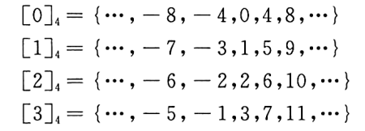
Products and Quotients of Groups
例题-求模4同余产生的整数划分构成的商集A/R

Slide 31
Products and Quotients of Groups
If R is a congruence relation on a group G, then the function
f_{R}: G→G/R given by f_{R}(a) = [a] is a group homomorphism.
If
f: G→G' is a homomorphism from the group (G, *) onto the group (G', *'), and
R is the relation defined on G by a R b if and only if f(a) = f(b), for a and b in G
Then
R is a congruence relation.
The function f: G/R →G', given by f([a]) = f(a) is an isomorphism from the group (G/R, ) onto the group (G', *' ).
f
S
T
f_{R}
f
S/R

Slide 32
Let H be a subgroup of a group G, a ∈ G
The left coset(左陪集) of H in G determined by a is the set aH = {ah| h ∈ H}
The right coset (右陪集) of H in G determined by a is the set Ha = {ha | h ∈ H}
A subgroup H of G is normal(正规子群) if aH = Ha, for all a in G
Let
R be a congruence relation on a group G
H = [e], the equivalence class containing the identity.
Then
H is a normal subgroup（正规子群） of G
[a] = aH = Ha, for each a ∈ G
The quotient group G/R consists of all the left cosets of N = [e].
The operation in G/R is given by (aN)(bN) = [a][b] = [ab] = abN
and the function f_{R}: G →G/R, defined by f_{R}(a) = aN is a homomorphism from G onto G/R. For this reason, we will often write G/R as G/N.

Slide 33
Groups and Coding
Encoding function（编码函数）
Choose an integer n >m and a one-to-one function e: B^{m} → B^{n}
e is called an (m, n) encoding function, representing every word in B^{m} as a word in B^{n}.
If b ∈ B^{m}, then e(b) is called the code word(码字) representing b.
(m,n) encoding function
parity(m,m+1) check code
(m,3m) encoding function
Error detection（差错检测）
We will say that the code word x = e(b) has been transmitted with k or fewer errors if x and x_{t} differ in at least 1 but no more than k positions.
Let e: B^{m} → B^{n} be an (m, n) encoding function. e detects k or fewer errors if whenever x = e(b) is transmitted with k or fewer errors, then x_{t} is not a code word (thus x_{t} could not be x and therefore could not have been correctly transmitted).
For x ∈ B^{n}, the number of l's in x is called the weight(权) of x and is denoted by |x|
Let x and y be words in B^{m}. The Hamming distance δ(x, y) between x and y is the weight, |x⊕y|, of x ⊕ y.

Slide 34
Groups and Coding
Let x, y, and z be elements of B^{m}. Then
(a) δ(x, y) = δ(y, x)
(b) δ(x, y) ≥ 0
(c) δ(x, y) = 0 if and only if x = y
(d) δ(x, y) ≤ δ(x, z) + δ(z, y)
The minimum distance（最短距离） of an encoding function e: B^{m} → B^{n} is the minimum of the distances between all distinct pairs of code words; that is,
min{δ(e(x), e(y)) | x, y ∈ B^{m}}
An (m, n) encoding function e: B^{m} → B^{n} can detect k or fewer errors if and only if its minimum distance is at 1east k + l.

Slide 35
Groups and Coding
An (m, n) encoding function e: B^{m} → B^{n} is called a group code（群码） if
e(B^{m}) = {e(b) | e(b) ∈ B^{n} } is a subgroup of B^{n}
Let e: B^{m} → B^{n} be a group code. The minimum distance of e is the minimum weight of a nonzero code word.

Slide 36
Constructing group code
mod-2 sum D ⊕ E
mod-2 Boolean product D * E（模2的布尔积）
Let m < n and r = n – m, the following n × r Boolean matrix is called a parity check matrix（奇偶校验矩阵）.
如何从B^{n}→B^{m}

Slide 37
Constructing group code
e_{H}(B^{m} ) = {e_{H}(b) | b ∈ B^{m}} is a subgroup of B^{n}

Slide 38
Decoding and Error Correction
Consider an (m, n) encoding function e: B^{m} → B^{n}. An onto function d: B^{n} → B^{m} is called an (n, m) decoding function associated with e(与e关联的译码函数) if d(x_{t}) = b' ∈ B^{m} is such that when the transmission channel has no noise, then b' = b, that is, d o e = 1_{Bm}
Let e be an (m, n) encoding function and let d be an (n, m) decoding function associated with e.
The pair (e, d) is said to correct（校正） k or fewer errors if whenever x = e(b) is transmitted correctly or with k or fewer errors and x_{t} is received, then d(x_{t}) = b. Thus x_{t} is decoded as the correct message b.
(e, d) can correct k or fewer errors if and only if the minimum distance of e is at least 2k + l.

Slide 39
Maximum likelihood technique
Since B^{m} has 2^{m} elements, there are 2^{m} code words in B^{m}. List it as
x⁽¹⁾, x⁽²⁾,..., x^{(2m)}
If the received word is x_{t}, we compute δ(x^{(i)},x_{t}) for 1 ≤i≤ 2^{m}, and choose the first code word, say it is x^{(s)}, such that
That is, x^{(s)} is a code word that is closest to x_{t} and the first in the list.
If x^{(s)} = e(b), we define the maximum likelihood decoding function（最大似然译码函数） d associated with e by d(x_{t}) = b

Slide 40
Coset leader（陪集首部）
Let e: B^{m} → B^{n} be an (m, n) encoding function that is a group code. Thus the set N of code words in B^{n} is a subgroup of B^{n} whose order is 2^{m}, say N = {x⁽¹⁾, x⁽²⁾,..., x^{(2m)}}.
Suppose that the code word x = e(b) is transmitted and that the word x_{t} is received.
The left coset of x_{t} is
x_{t} ⊕ N = {ε₁, ε₂,..., ε_{2m}} where ε_{i} = x_{t} ⊕ x^{(i)}
if ε_{j} is a coset member with smallest weight, then x^{(j)} must be a code word that is closest to x_{t}.
An element ε_{j} , having smallest weight, is called a coset leader

Slide 41
Constructing maximum likelihood decoding function associated with a given group code
For obtaining a maximum likelihood decoding function d associated with a given group code e: B^{m} → B^{n}
Step 1: Determine all the left cosets of N = e(B^{m}) in B^{n}
Step 2: For each coset, find a coset leader (a word of least weight).
Step 3: If the word x_{t} is received, determine the coset of N to which x_{t} belongs.
Step 4: Let ε be a coset leader for the coset determined in Step 3. Compute x = x_{t} ⊕ ε. If x = e(b), let d(x_{t}) = b.
Decoding table

Slide 42
Syndrome
Suppose that the (m, n) group code is e_{H}: B^{m} → B^{n} , where H is a given parity check matrix.
Then the function f_{H}: B^{n} → B^{r} defined by f_{H}(x) = x*H, x ∈ B^{n} is a homomorphism from the group B^{n} to the group B^{r}.
B^{r} and B^{n}/N are isomorphic, where N = {x ∈ B^{n} | x*H = 0} = ker(f_{H}) = e_{H}(B^{m} ) under the isomorphism g: B^{n}/N → B^{r} defined by g(xN) = f_{H}(x) = x*H
The element x*H is called the syndrome（校验子） of x

Slide 43
Syndrome and decoding procedure for group code
Let x and y be elements in B^{n}. Then
x and y lie in the same left coset of N in B^{n}
if and only if f_{H}(x) = f_{H}(y)
if and only if they have the same syndrome.
Decoding procedure
Step 1: Determine all left cosets of N = e_{H}(B^{m} ) in B^{n}.
Step 2: For each coset, find a coset leader, and compute the syndrome of each leader
Step 3: If x_{t} is received, compute the syndrome of x_{t} and find the coset leader ε having the same syndrome. Then x_{t} ⊕ ε = x is a code word e_{H}(b), and d(x_{t}) = b.

Slide 44
8 Advanced Counting Techniques
8.1 Recurrence Relations（递推关系）
8.2 Solving Recurrence Relations
Linear homogeneous recurrence relations with constant coefficients of degree k （k阶齐次常系数线性递推关系）
8.3 Divide-and-Conquer Algorithms and Recurrence Relations（分治算法和递推关系）
8.4 Generating Functions（生成函数）

Slide 45
§8.1: Recurrence Relations
A recurrence relation (R.R., or just recurrence) for a sequence {a_{n}} is an equation that expresses a_{n} in terms of one or more previous elements a₀, …, a_{n−1} of the sequence, for all n≥n₀.
A recursive definition, without the base cases.
A particular sequence (described non-recursively) is said to solve the given recurrence relation if it is consistent with the definition of the recurrence.
A given recurrence relation may have many solutions.

Slide 46
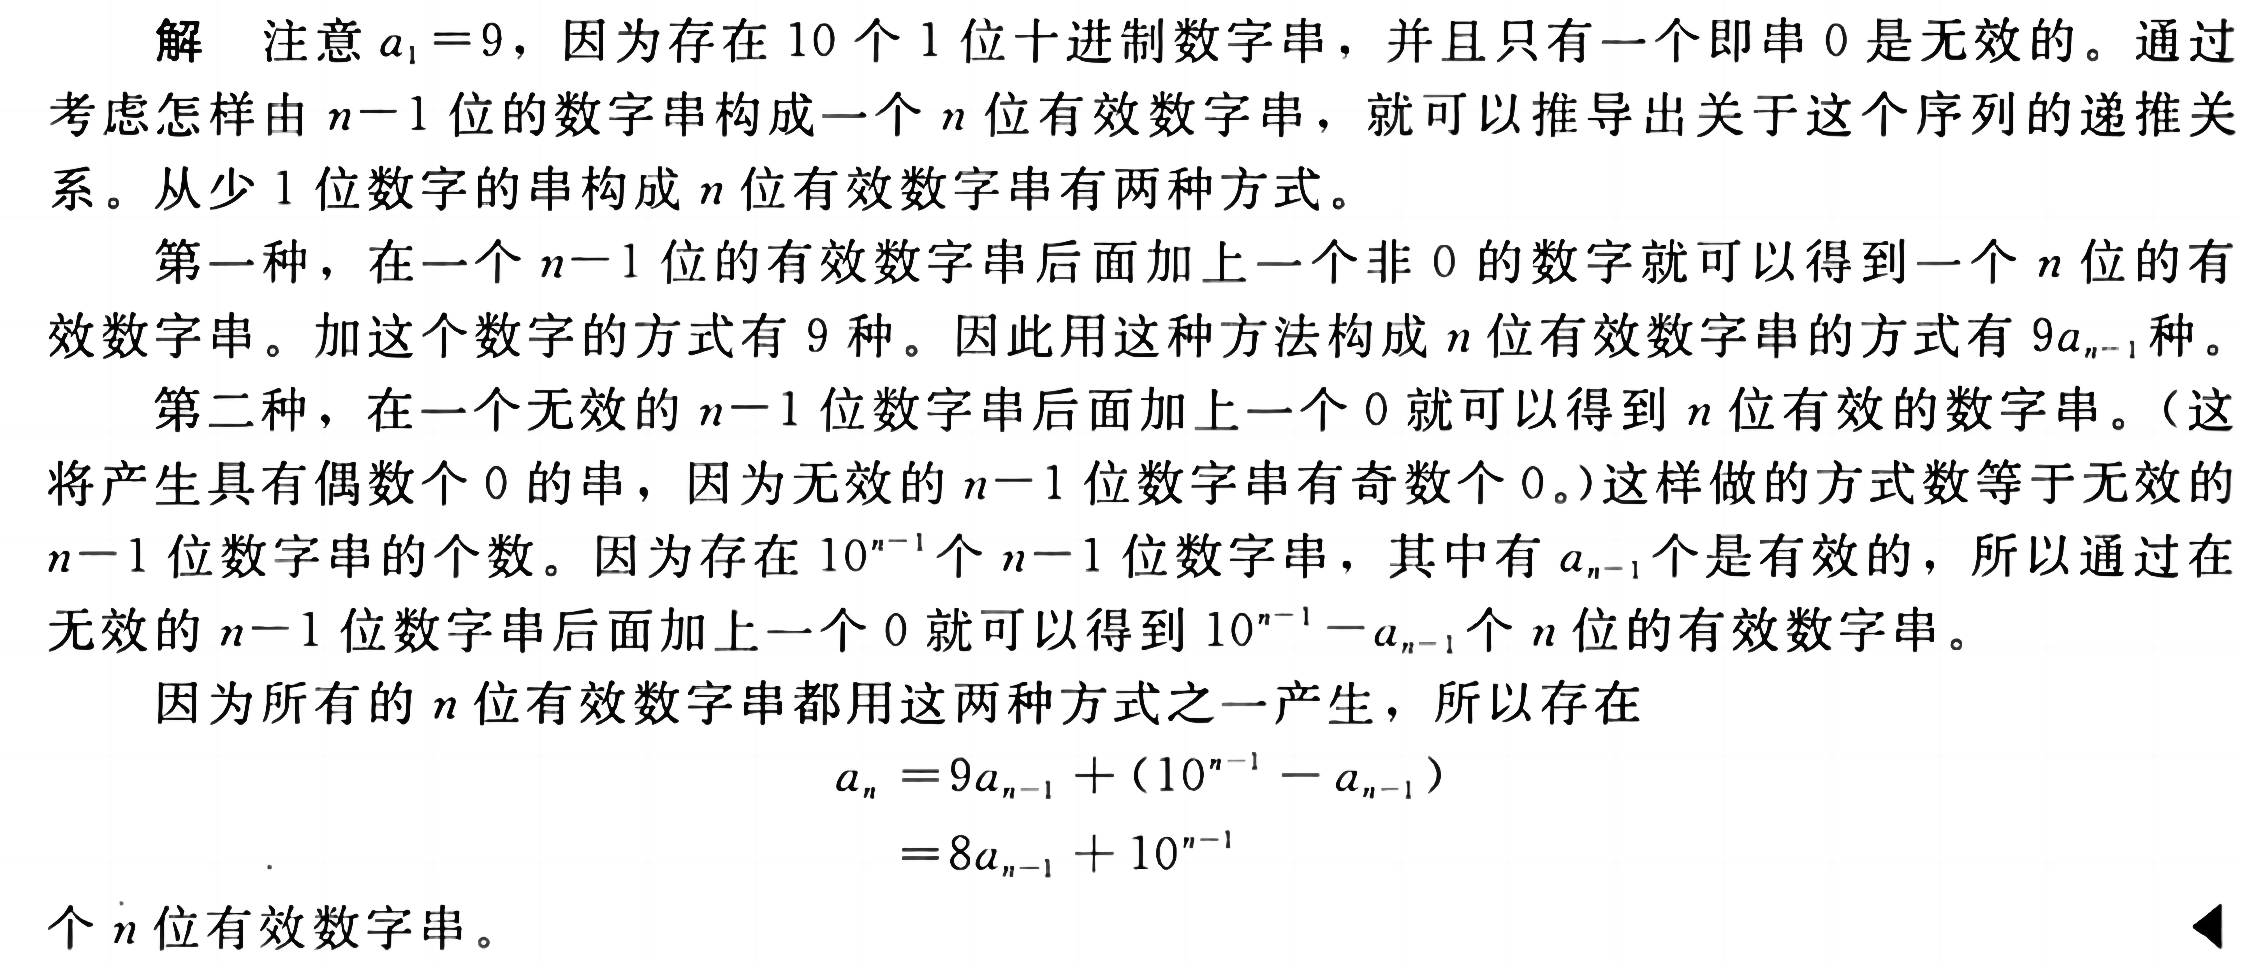

§8.1: Recurrence Relations
例题-如果一个十进制数字串包含偶数个 0，计算机系统就把它作为一个有效的编码字。例如，1230407869 是有效的，而 120987045608 不是有效的。设 $a_{n}$是有效的n位编码字的个数。找出一个关于$a_{n}$的递推关系。

Slide 47
§8.2: Solving Recurrences
A linear homogeneous recurrence of degree k with constant coefficients (“k-LiHoReCoCo”,k阶定常系数线性齐次递推关系) is a recurrence of the form a_{n} = c₁a_{n−1} + … + c_{k}a_{n−k}, where the c_{i,} (i = 1, .., k) are all real, and c_{k} ≠ 0.
Note
On the right-hand side, the summands(被加数） are each built the same (homogeneous) way as a multiple of one of the k (degree k) previous terms (linear).
The solution is uniquely determined if k initial conditions a₀…a_{k−1} are provided.

Slide 48
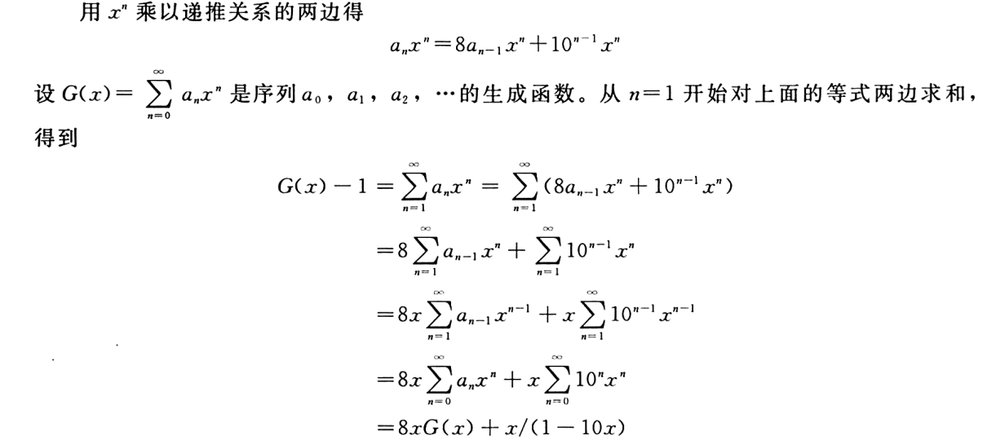
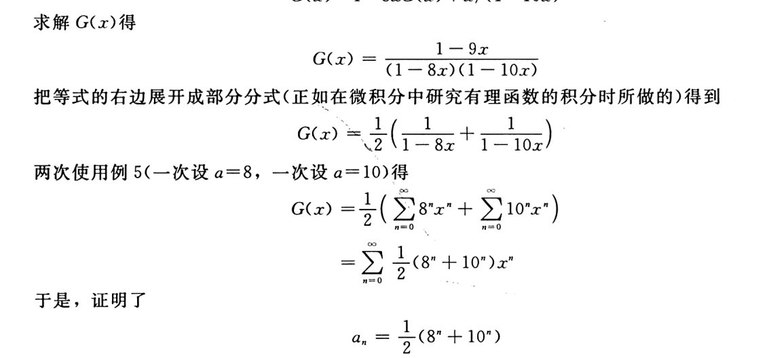
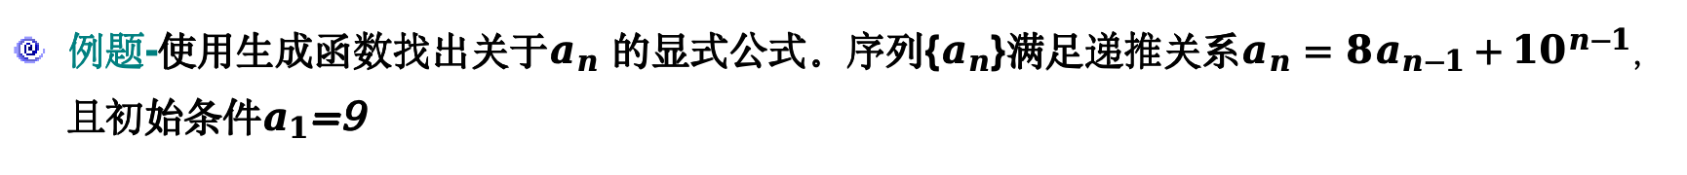
§8.2: Solving Recurrences
例题-使用生成函数找出关于$a_{n}$的显式公式。序列{$a_{n}$}满足递推关系$a_{n}=8a_{n−1}+{10}^{n−1}$，且初始条件$a_{1}$=9

Slide 49
§8.2: Solving Recurrences
A linear homogeneous recurrence of degree k with constant coefficients (“k-LiHoReCoCo”,k阶定常系数线性齐次递推关系) is a recurrence of the form a_{n} = c₁a_{n−1} + … + c_{k}a_{n−k}, where the c_{i,} (i = 1, .., k) are all real, and c_{k} ≠ 0.
Note
On the right-hand side, the summands(被加数） are each built the same (homogeneous) way as a multiple of one of the k (degree k) previous terms (linear).
The solution is uniquely determined if k initial conditions a₀…a_{k−1} are provided.

Slide 50
§8.2: Solving Recurrences
Characteristic equation (特征方程）
For a linear homogeneous recurrence relation of degree k, We call the associated polynomial of degree k, x^{k}=c₁x^{k-1}+c₂x^{k-2}+…+c_{k,}its characteristic equation (特征方程）.
The roots of the characteristic equation play a key role in the explicit formula for the sequence defined by the recurrence relation and the initial conditions.

Slide 51
Solving 2-LiHoReCoCos
Consider an arbitrary 2-LiHoReCoCo: a_{n} = c₁a_{n−1} + c₂a_{n−2}
It has the characteristic equation (C.E.): r² − c₁r − c₂ = 0
Thm. 1: If this CE has 2 roots r₁≠r₂, then a_{n} = α₁r₁^{n} + α₂r₂^{n} for n≥0 for some constants α₁, α₂.

Slide 52
The Case of Degenerate Roots
Now, what if the C.E. r² − c₁r − c₂ = 0 has only 1 root r₀?
Theorem 2: Then, a_{n} = α₁r₀^{n} + α₂nr₀^{n}, for all n≥0, for some constants α₁, α₂.
Note:
Fibonacci Numbers：F（n）=F（n-1)+F(n-2), F(0)=0, F(1) =1.

Slide 53
Degenerate k-LiHoReCoCos
Suppose there are t roots r₁,…,r_{t} with multiplicities m₁,…,m_{t}. Then:
for all n≥0, where all the α are constants.

Slide 54
Solutions of LiNoReCoCos
A useful theorem about LiNoReCoCos:
If a_{n} = p(n) is any particular solution to the LiNoReCoCo
Then all its solutions are of the form: a_{n} = p(n) + h(n), where a_{n} = h(n) is any solution to the associated homogeneous RR

Slide 55
§8.3: Divide & Conquer R.R.s
Main points so far:
Many types of problems are solvable by reducing a problem of size n into some number a of independent subproblems, each of size ≤⎡n/b⎤, where a≥1 and b>1.
The time complexity to solve such problems is given by a recurrence relation:
T(n) = a·T(⎡n/b⎤) + g(n)

Slide 56
The Master Theorem
Consider a function f(n) that, for all n=b^{k} for all k∈Z⁺,,satisfies the recurrence relation:
f(n) = af(n/b) + cn^{d}
with a≥1, integer b>1, real c>0, d≥0. Then:

Slide 57
§8.4: Generating Functions
Definition: The generating function for the sequence a₀,a₁….a_{k} of real numbers is the infinite series

Slide 58
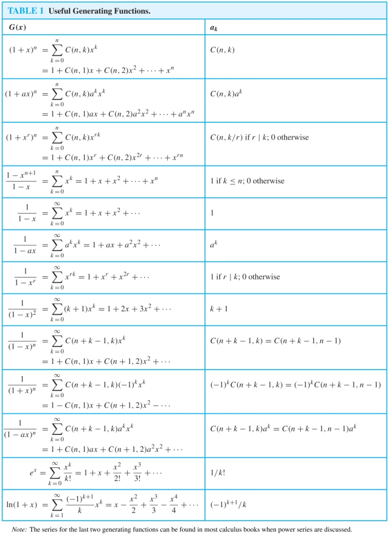
§8.4: Generating Functions
Table 1 Useful Generating Functions

Slide 59
§8.4: Generating Functions
Counting problems and Generating Functions
Example 10
Find the number of solutions of e₁+e₂+e₃ =17, where e₁, e₂, and e₃ are nonnegative integers with 2 ≤ e₁ ≤ 5, 3 ≤ e₂ ≤ 6, and 4 ≤ e₃ ≤ 7.
the coefficient of x¹⁷in this product is 3.

Slide 60
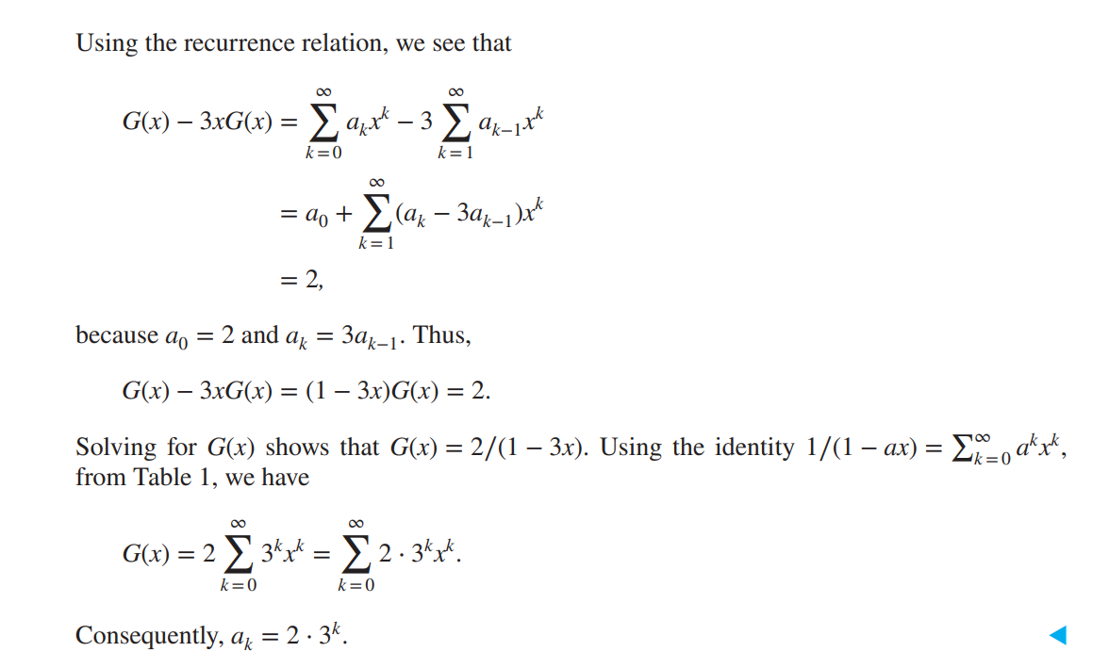

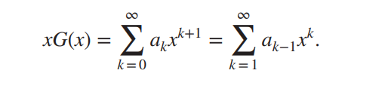
§8.4: Generating Functions
Using Generating Functions to Solve Recurrence Relations
Example 16
Solve the recurrence relation a_{k}= 3a_{k-1} for k=1,2,3… and initial condition a₀=2

Slide 61
Types of Graphs
Simple graph （简单图）
Multigraph （多重图）
Pseudograph （伪图）
Simple directed graph （简单有向图）
Directed multigraph （多重有向图）
Mixed graph （混合图）

Slide 62
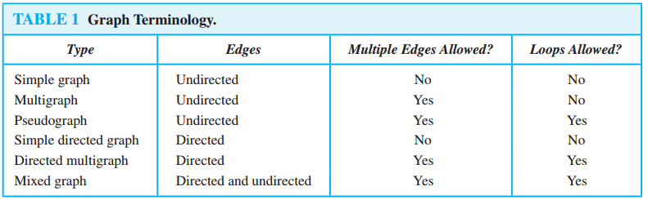
Types of Graphs: Summary
Summary of the book’s definitions.
Keep in mind this terminology is not fully standardized across different authors...

Slide 63
Graph models
Social Networks
Information Networks
Software Design Applications
Transportation Networks
Biological Networks
Tournaments

Slide 64
§10.2 Graph Terminology
You need to learn the following terms:
Adjacent, connects, endpoints, degree, initial, terminal, in-degree, out-degree, complete, cycles, wheels, n-cubes, bipartite, subgraph, union.

Slide 65
Special Graph Structures
Special cases of undirected graph structures:
Complete graphs（完全图） K_{n}
Cycles（圈图） C_{n}
Wheels（轮图） W_{n}
n-Cubes（n立方图） Q_{n}
Bipartite graphs（二分图）
Complete bipartite graphs（完全二分图） K_{m,n}

Slide 66
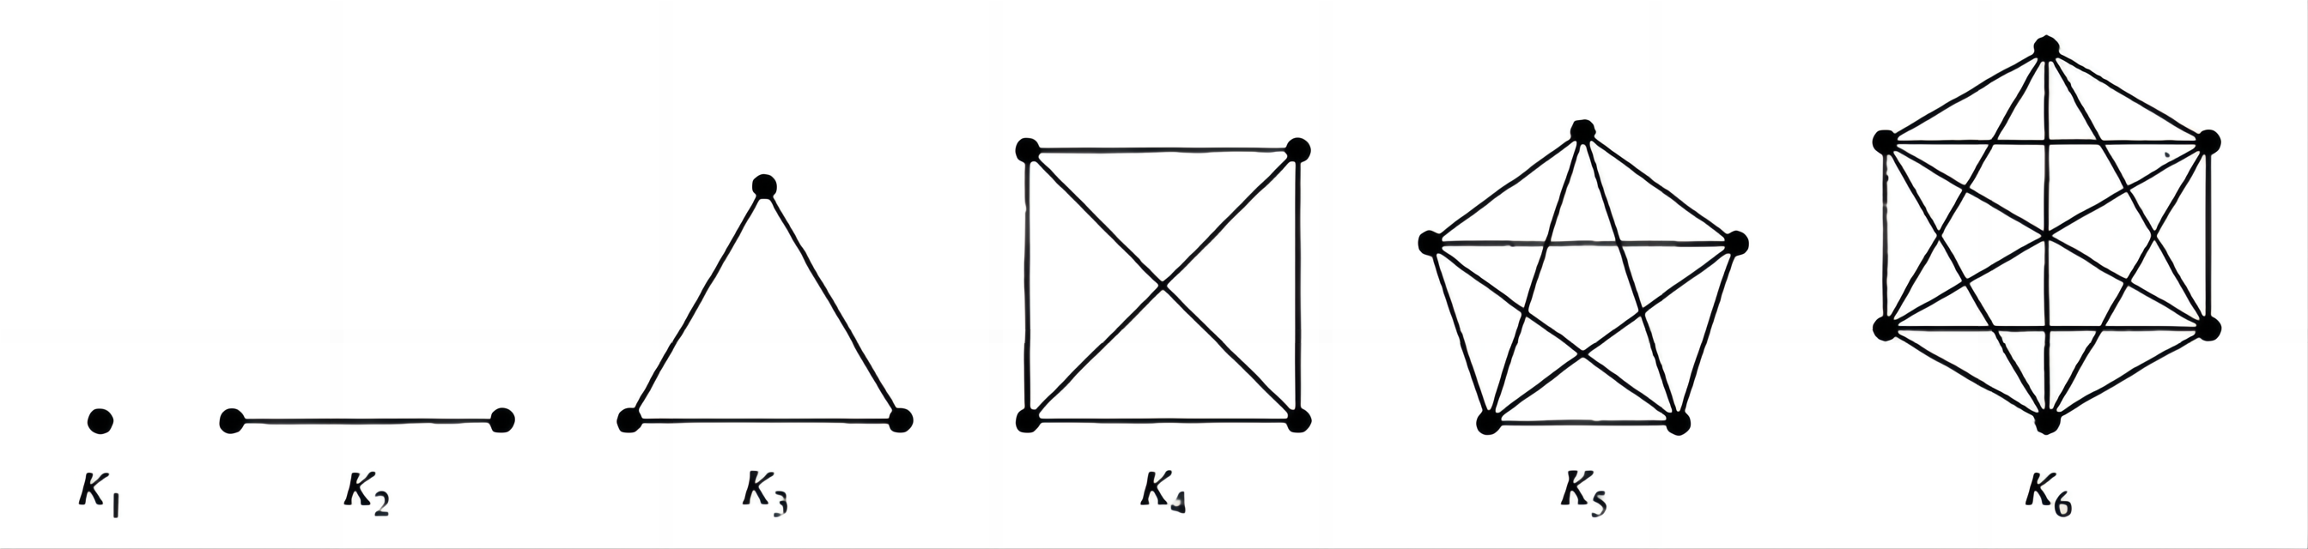
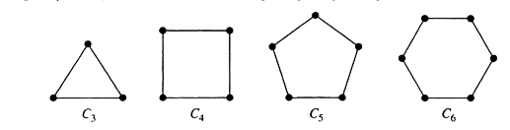

Special Graph Structures
Complete graphs/完全图$K_{n}$：n个顶点的完全图记作 $K_{n}$，是在每对不同顶点之间都恰有一条边的简单图。下图显示了 n=1，2，3，4，5，6 的图$K_{n}$。至少有一对不同的顶点不存在边相连的简单图称为非完全图。
Cycles/圈图$C_{n}$：$C_{n}$(n≥3)是由n个顶点$v_{1}，v_{2},...,v_{n,}$以及边$\{v_{1},v_{2}\},...,\{v_{n},v_{1}\}$组成的。

Slide 67
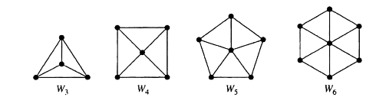
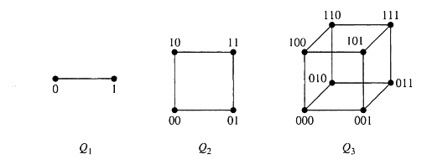

Special Graph Structures
Wheels/轮图 $W_{n}$： 当给圈图 $C_{n}$，n>3，添加另一个顶点，并把这个新顶点与$C_{n}$中的n 个顶点逐个连接时，就得到轮图 $W_{n}$。
n-Cubes/n立方体图$Q_{n}$：n 立方体图记作 $Q_{n}$，是用顶点表示 $2^{n}$个长度为n的比特串的图。两个顶点相邻，当且仅当它们所表示的比特串恰恰有一位不同。

Slide 68
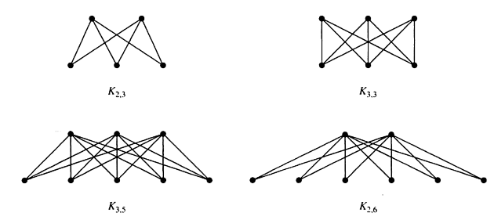

Special Graph Structures
Complete bipartite graphs/完全二分图$K_{m,n}:$ 完全二分图$K_{m,n}$是顶点集划分成分别含有m 和n 个顶点的两个子集的图，并且两个顶点之间有边当且仅当一个顶点属于第一个子集而另一个顶点属于第二个子集。

Slide 69
§10.3: Graph Representations & Isomorphism
Graph representations（图示法）:
Adjacency lists.
Adjacency matrices.
Incidence matrices.
Graph isomorphism（图同构）:
Two graphs are isomorphic iff they are identical except for their node names.

Slide 70
§10.4: Connectivity
In an undirected graph, a path of length n from u to v is a sequence of adjacent edges going from vertex u to vertex v.
A path is a circuit if u=v.
A path pass through the vertices or traverses the edges.
A path is simple if it contains no edge more than once.

Slide 71
Connectedness
An undirected graph is connected if there is a path between every pair of distinct vertices in the graph.

Slide 72
Connectedness
A cut vertex or cut edge (bridge) separates 1 connected component into 2 if removed.

Slide 73
Vertex Connectivity
Nonseparable graphs
Connected graphs without cut vertices are called nonseparable graphs
Vertex cut
A subset V′ of the vertex set V of G = (V, E) is a vertex cut, or separating set, if G − V′ is disconnected.

Slide 74
Edge Connectivity
Edge cut（边切割）
A set of edges E′ is called an edge cut of G if the subgraph G − E ′ is disconnected.
Edge connectivity（边连通性）
The edge connectivity of a graph G, denoted by 𝜆(G), is the minimum number of edges in an edge cut of G.
𝜆(G) = 0 if G is not connected or G has a single vertex.
If G is a graph with n vertices, then 0 ≤ 𝜆(G) ≤ n − 1.
𝜆(G) = n − 1 where G is a graph with n vertices if and only if G = K_{n}.

Slide 75
Directed Connectedness
A directed graph is strongly connected if there is a path from a to b and from b to a whenever a and b are vertices in the graph.
It is weakly connected if there is a path between every two vertices in the underlying undirected graph.
Note strongly implies weakly but not vice-versa.

Slide 76
Counting Paths by Adjacency Matrices
Let A be the adjacency matrix of graph G.
The number of paths of length k from v_{i} to v_{j} is equal to (A^{k})_{i,j}.
The notation (M)_{i,j} denotes m_{i,j} where [m_{i,j}] = M.

Slide 77
Eulerian graph（欧拉图）
An Euler circuit（欧拉回路） in a graph G is a simple circuit containing every edge of G.
An Euler path（欧拉通路） in G is a simple path containing every edge of G.
A walk in a graph is called an Euler tour（欧拉环游） if it starts and ends in the same place and uses each edge exactly once.
A walk in a graph is called an Euler trail（欧拉迹） if it uses each edge exactly once.
If a graph has an Euler tour, it is said to be an Eulerian graph（欧拉图）.

Slide 78
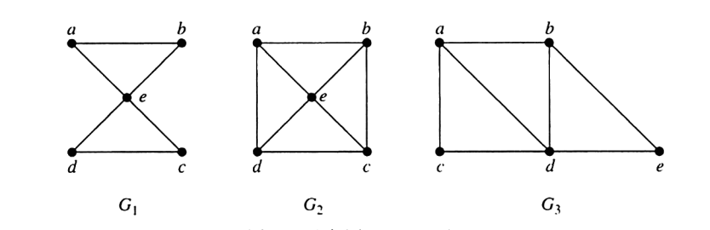
Eulerian graph（欧拉图）
欧拉回路/Euler circuit、欧拉通路/Euler path：图G中的欧拉回路是包含G的每一条边的简单回路。图G中的欧拉通路是包含G的每一条边的简单通路。
例题-下图中哪些无向图有欧拉回路,在没有欧拉回路的那些图，哪些具有欧拉通路？
图G₁具有欧拉回路，例如a,e,c,d,e,b,a。G₂和G₃都没有欧拉回路。
但是G₃具有欧拉通路，即a,c,d,e,b,d,a,b。G₂没有欧拉通路

Slide 79
Hamiltonian Graph（哈密顿图）
A graph has a Hamiltonian tour（哈密顿环游） if there is a tour that visits every vertex exactly once (and returns to its starting point).
A graph with a Hamiltonian tour is called a Hamiltonian graph（哈密顿图）.
A Hamiltonian path（哈密顿通路） is a path that contains each vertex exactly once.
A Hamilton circuit is a circuit that traverses each vertex in G exactly once.
A Hamilton path is a path that traverses each vertex in G exactly once

Slide 80
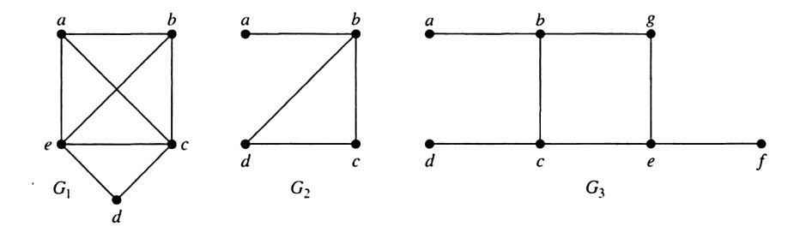
Hamiltonian Graph（哈密顿图）
哈密顿通路/Hamilton path、哈密顿回路/Hamilton circuit：经过图 G中每一个顶点恰好一次的简单通路称为哈密顿通路，经过图 G中每一个顶点恰好一次的简单回路称为哈密顿回路。
例题-下图中哪些简单图有哈密顿回路,在没有哈密顿回路的那些图，哪些具有哈密顿通路？
解 G₁有哈密顿回路：a,b,c,d,e,a。G₂没有哈密顿回路(可以看出包含每一个顶点的任何回路必然两次包含边{a,b}),
G₂确实有哈密顿通路，即a,b,c,d。
G₃既无哈密顿回路也无哈密顿通路，因为包含所有顶点的任何通路都必须多次包含边{a,b}、{e,f}和{c,d}其中之一。

Slide 81
Shortest Path Problem
There are two types of such problems
Determining the shortest path（最短路径） from a vertex to an assigned vertex.
Determining the shortest path of any two vertices in the graph.

Slide 82
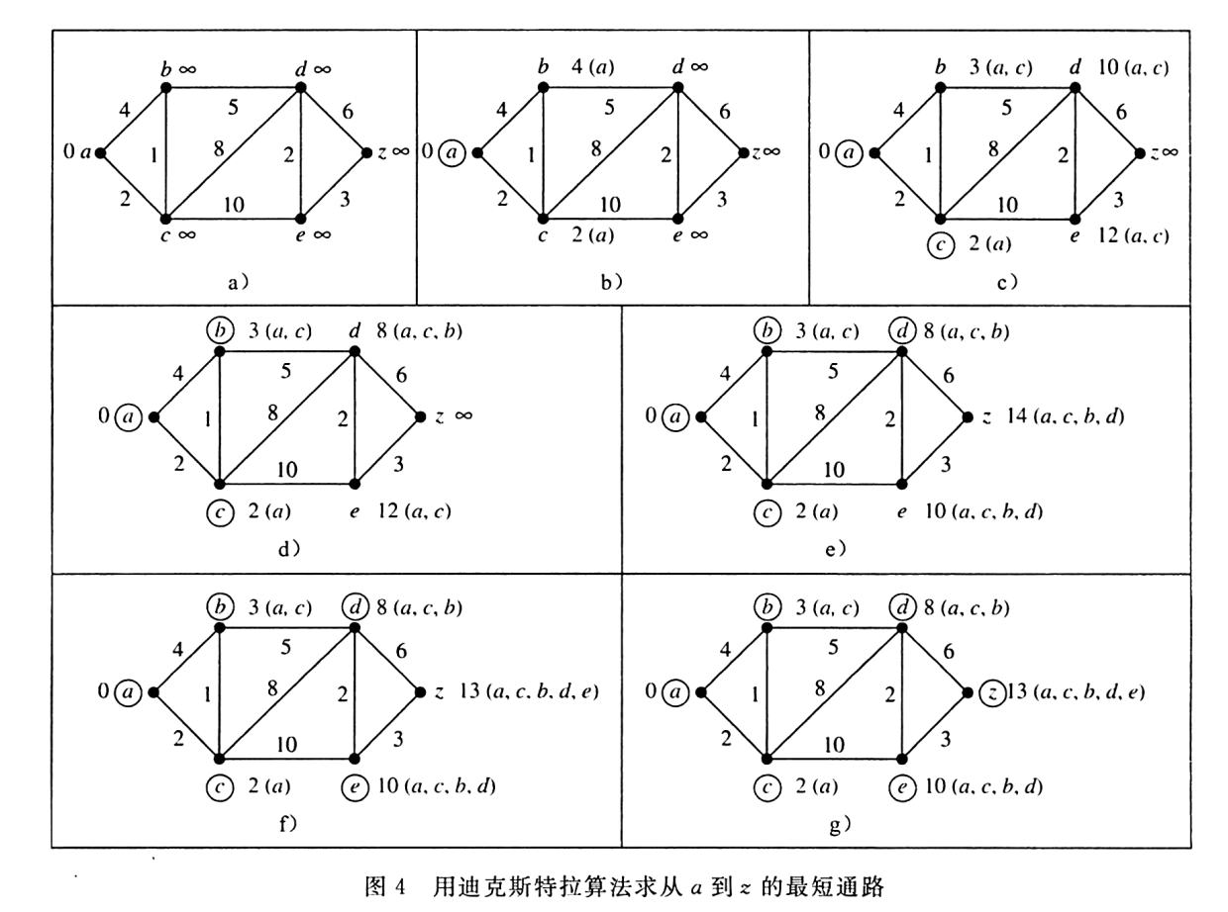
Shortest Path Problem
例题

Slide 83
Planar Graphs – 平面图
A graph is called planar（平面） if it can be drawn in the plane in such a way that no two edges cross.
Example of a planar graph: The clique on 4 nodes.

Slide 84
Euler Theorem 1752
Let G be a connected planar simple graph with e edges and v vertices. Let r be the number of regions in a planar representation of G. Then r = e − v +2.

Slide 85
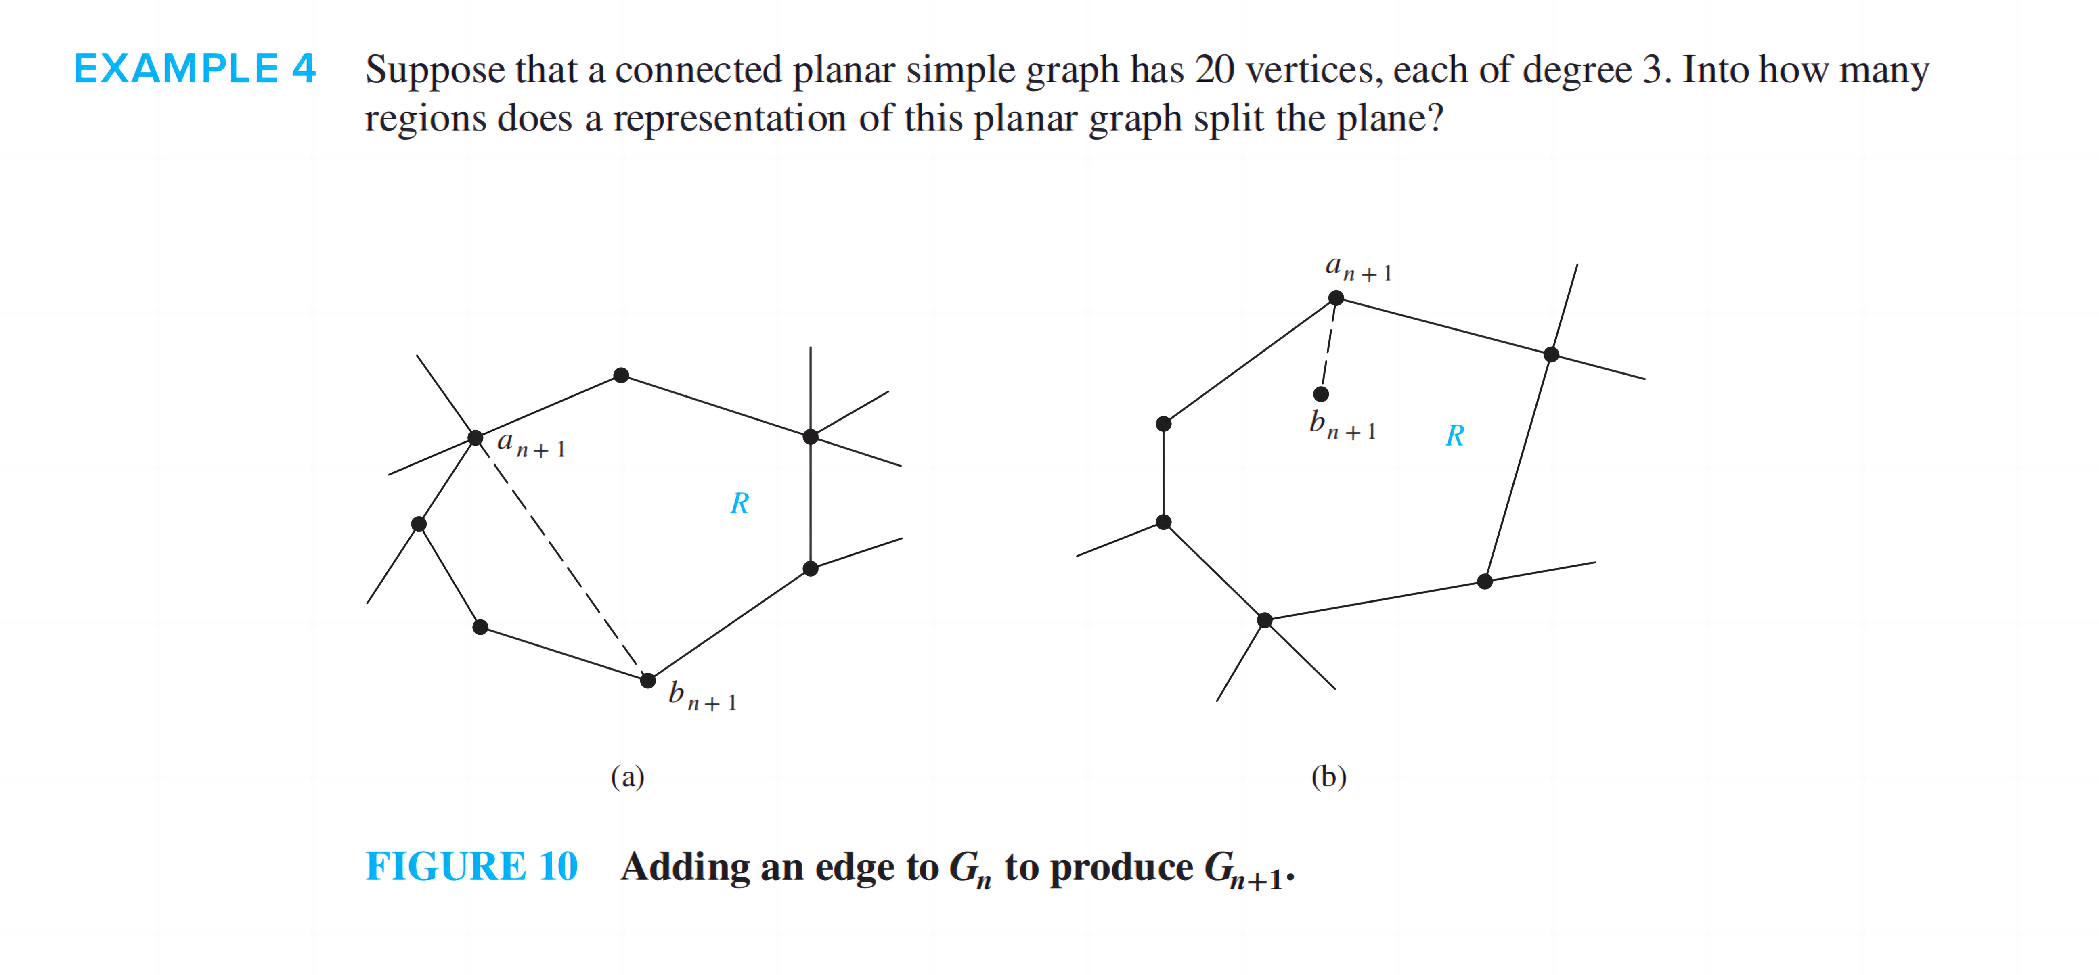
Theorem
例题

Slide 86
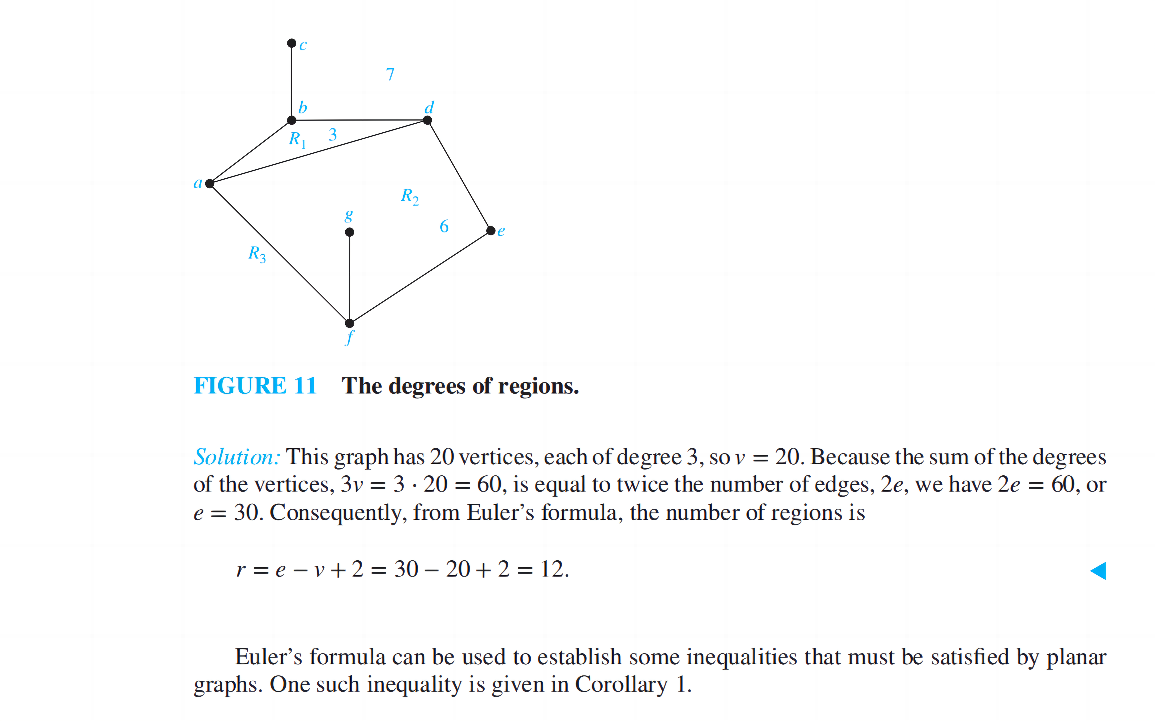
Theorem
例题

Slide 87
Theorem
Every (simple) n-node planar graph G has at most 3n-6 edges.

Slide 88
corollary
If G is a connected planar simple graph, then G has a vertex of degree not exceeding five.
If a connected planar simple graph has e edges and v vertices with v≥3 and no circuit of length three, then e≤2v-4

Slide 89
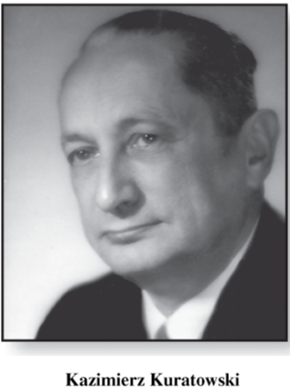
Kuratowski’s Theorem [1930]
A graph is nonplanar
if and only if
it contains a subgraph homeomorphic to K_{3,3} or K₅.

Slide 90
Coloring graphs
Suppose that G = (V, E, γ) is a graph with no multiple edges, and C = {c₁, c₂, …, c_{n}} is any set of n “colors”.
Any function f: V → C is called a coloring of the graph G using n colors (or using the colors of C).
For each vertex v, f(v) is the color of v.

Slide 91
χ(G)
A coloring is proper (合适的) if any two adjacent vertices v and u have different colors.
The smallest number of colors needed to produce a proper coloring of a graph G is called the chromatic number of G(G的着色数), denoted by χ(G).

Slide 92
Another problem
Computing the total number of different proper colorings of a graph G using a set {c_{l} ,c₂ , . . . , c_{n}} of colors.

Slide 93
Chromatic Polynomials
If G is a graph and n ≥ 0 is an integer, let P_{G}(n) be the number of ways to color G properly using n or fewer colors.
P_{G} is called the chromatic polynomial(着色多项式) of G.

Slide 94
Theorem 1
If G is a disconnected graph with components G₁, G₂, . . . . G_{m}, then P_{G}(x) is the product of the chromatic polynomials for each component
P_{G}(x) = P_{G1}(x) P_{G2}(x) . . . P_{Gm}(x)

Slide 95
Theorem 2
Let G = (V, E, γ) be a graph with no multiple edges, and let e ∈ E, say e = {a, b}.
G_{e} : subgraph of G obtained by deleting e,
G^{e} : the quotient graph of G obtained by merging the end points of e.
Then with x colors:

Slide 96
Theorem 2
Let G = (V, E, γ) be a graph with no multiple edges, and let e ∈ E, say e = {a, b}.
G_{e} : subgraph of G obtained by deleting e,
G^{e} : the quotient graph of G obtained by merging the end points of e.
Then with x colors:

Slide 97
Content
Application of digraph
Concept
Capacity (容量)
Transport network (传输网)
Flow (流量)
Virtual flow (虚流量)
Maximal flow (最大流量)
Labeling algorithm (标记算法)

Slide 98
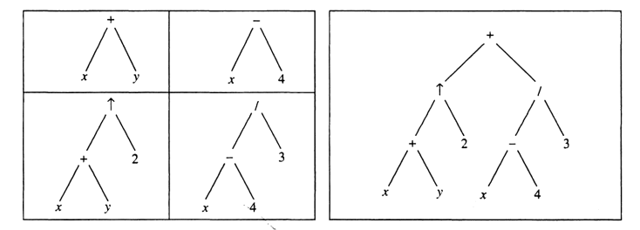
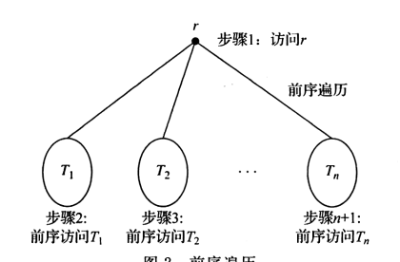
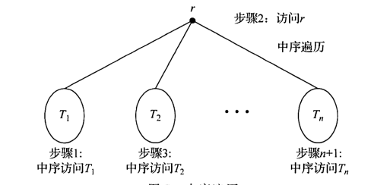
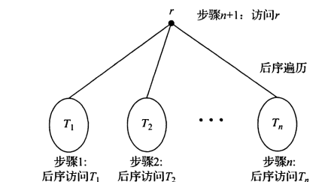
Trees
前序遍历/preorder traversal
中序遍历/inorder traversal
后序遍历/postorder traversal
前缀表示法/prefix notation
中缀表示法/infix notation
后缀表示法/postfix notation
表示表达式((x+y)↑2)+((x-4/3))的有序根树
前序遍历
中序遍历
后序遍历

Slide 99
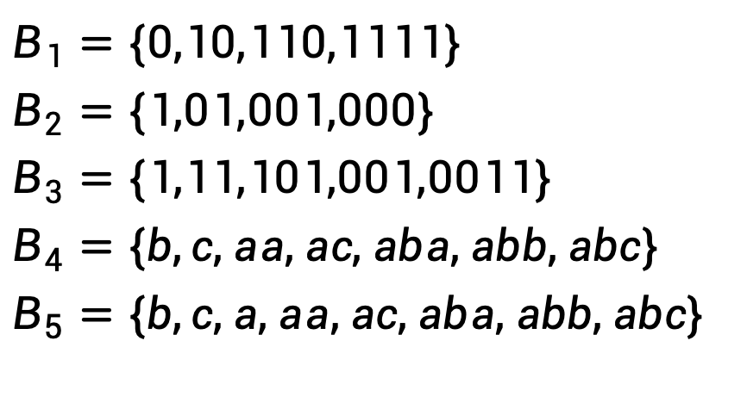
Trees
前缀码/Prefix Codes
[定义]前缀：ａ，ｂ，ｃ均为二进制序列，如果ｂ＝ａ并列ｃ，ｃ不是空序列，则称ａ是ｂ的前缀/prefix。即ａ是ｂ的前面一部分。
[定义] 前缀码：一个二进制序列集合，如果这些二进制序列互不为前缀，则称此集合为前缀码/prefix code。
二元前缀码：设a_1,a_2,⋯,a_(n−1), a_n是长为n的符号串, a_1,a_1,a_2⋯,a_1, a_2⋯a_(n−1)均为该符号串的前缀，它们的长度分别为 1,2, ⋯, n-1。
$$B_{1}=\{0,10,110,1111\}$$
$$B_{2}=\{1,01,001,000\}$$
$$B_{3}=\{1,11,101,001,0011\}$$
$$B_{4}=\{b,c,aa,ac,aba,abb,abc\}$$
$$B_{5}=\{b,c,a,aa,ac,aba,abb,abc\}$$
√
√
×
√
×

Slide 100
Trees
EXAMPLE 5
Use Huffman coding to encode the following symbols with the frequencies listed: A: 0.08, B: 0.10, C: 0.12, D: 0.15, E: 0.20, F: 0.35. What is the average number of bits used to encode a character?

Slide 101
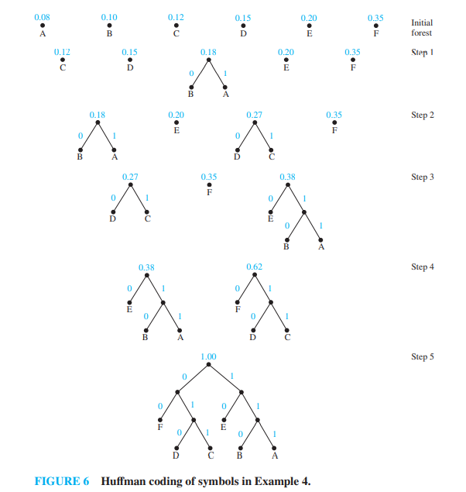
Trees
Solution: Figure 6 displays the steps used to encode these symbols. The encoding produced encodes A by 111, B by 110, C by 011, D by 010, E by 10, and F by 00. The average number of bits used to encode a symbol using this encoding is
3 ⋅ 0.08 + 3 ⋅ 0.10 + 3 ⋅ 0.12 + 3 ⋅ 0.15 + 2 ⋅ 0.20 + 2 ⋅ 0.35 = 2.45

Slide 102
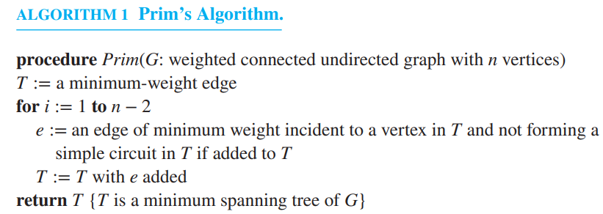
Trees
Minimal Spanning Trees(最小生成树)
生成树：包含图的所有顶点的树
[定义]最小生成树：边的权之和最小的生成树

Slide 103
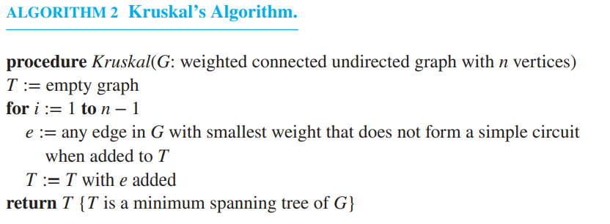
Trees
Minimal Spanning Trees(最小生成树)

Slide 104
Trees
Minimal Spanning Trees(最小生成树)
例

Slide 105
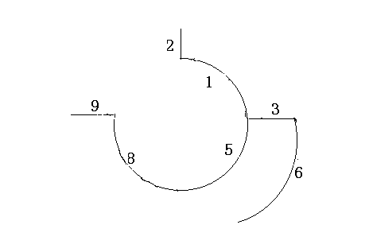
Trees
解题过程：
(1）边排序:(v1,v2),(v2,v7),(v1,v6),(v6,v7)
(v1,v4),(v5,v6),(v4,v5),(v3,v4),(v3,v8)
(v5,v8),(v2,v3),(v7,v8)
(2) 选s1={e1} e1=(v1,v2)
(3) 选e2=(v2,v7)
(4) e3=(v1,v6)
(5) e4=(v1,v4)=5
(6) e5=(v5,v6)=6
(7) e6=(v3,v4)=8
(8) e7=(v3,v8)

Slide 106
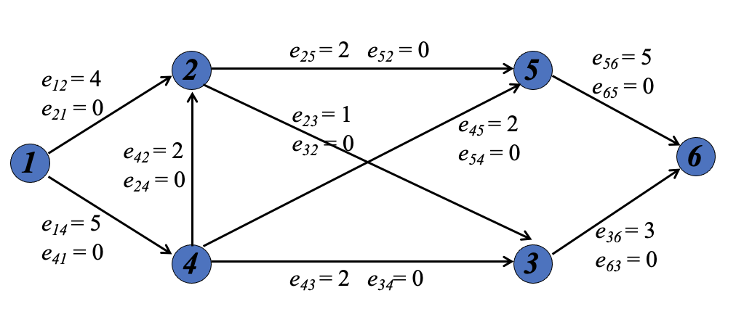
10.8.2 Applications of Graph Colorings
例题-Find a maximum flow in the given network by using the labeling algorithm. And find a minimum cut of this network. (Please give out the labeling graph of every flow.)

Slide 107
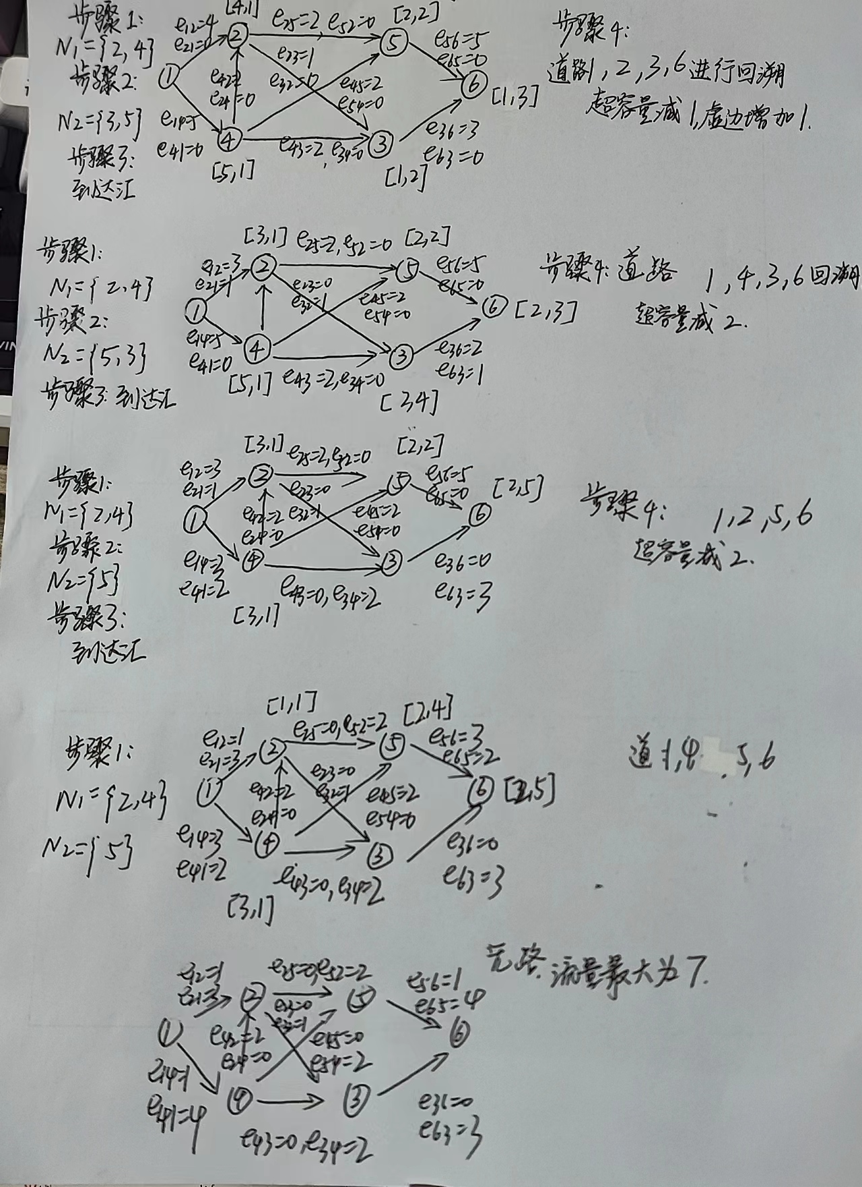
10.8.2 Applications of Graph Colorings

